Slide 1
Welcome

Slide 2
What This Course Will Cover
Cascading Style Sheets
Why they are a better way
The syntax
Development Tools
Accessibility Issues

Slide 3
Week One
Focus is on getting your feet wet:
What are the three common methods for styling your code?
How do these methods interact?
Basic styling of fonts
Introduction to placing elements

Slide 4
Week Two
The Box Model
Styling links and lists
Advanced Selectors
Browser Capabilities

Slide 5
Week Three
Pseudo Classes and Elements
Transitions
Transforms
Positioning

Slide 6
Week Four
Samples, samples, samples
Styling a table
Styling a navigation menu
Working on Final Project

Slide 7
Who is this class for?
This class is for those who are already familiar with HTML5.
Who have persistence
Who are willing to do more than I do in these lectures.

Slide 8
Who Am I?
Ph.D. in Computer Science
Two decades of teaching experience
Emphasis on education for those who running around classrooms while helping students debug

Slide 9
Workload
Weekly quizzes – short
Weekly peer-graded assignments
Demonstrate general capabilities to code what we have learn. Every student will have the same html, but will create a unique look.

Slide 10
Succeeding in This Class
In a perfect world you would code with a friend…so use the message boards.
Never spend more than 15 minutes on one thing that doesn’t work. Move on.
Look things up on your own!
Practice, practice, practice!

Slide 11

Acknowledgements/Contributions
These slides are Copyright 2015- Colleen van Lent as part of http://www.intro-webdesign.com/ and made available under a Creative Commons Attribution-NonCommercial 4.0 License. Please maintain this last slide in all copies of the document to comply with the attribution requirements of the license. If you make a change, feel free to add your name and organization to the list of contributors on this page as you republish the materials.
Initial Development: Colleen van Lent , University of Michigan School of Information

Slide 12
CSS3 Cascading Style Sheets
Adding Style to your Pages

Slide 13
Browser Default Styling
The same html file may look different when viewed on different browsers.
Some tags are supported, some aren’t
Browsers may have different default styles
In general, default looks are plain.

Slide 14

Adding Style
As styling tags were phased out of html, styling was done with style attribute
Violated separation of content/style

Slide 15
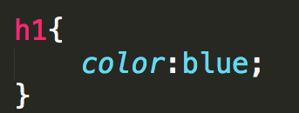
Cascading Style Sheet
CSS defined generic rules that can apply to multiple elements
selector {
property: value;
}

Slide 16
Rule Syntax
Brackets and semicolons are very important
This is where a good editor can make a BIG difference

Slide 17
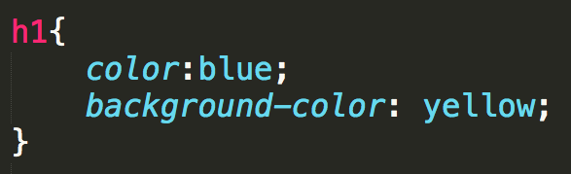

Multiple Properties

Slide 18
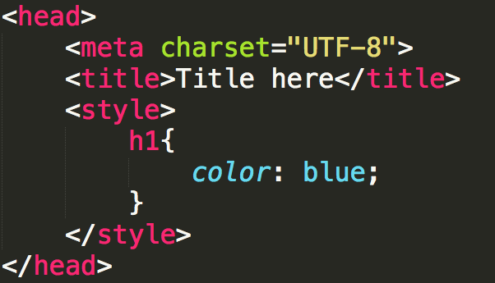
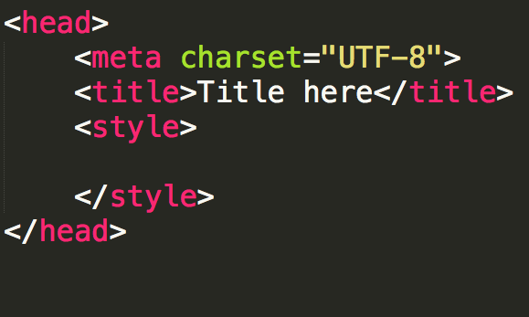
Internal Style Sheet
Styling is defined within <head>
Rules are defined within <style>
Styles are applied to all elements in that file
Don’t forget to close the style tag!!

Slide 19
External Style Sheet
You can put rules in an external file (don’t use the style tag!!)
A link to the style sheet is put in the head section.
Styles are applied to all elements in all files that links to the style sheet

Slide 20
The “Cascading” part of CSS
Browser default
External style sheets
Internal style (in the head section)
Inline style (inside an HTML element)

Slide 21
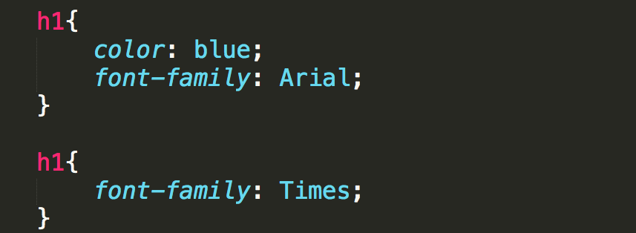
Rule precedence
What if one selector is defined in two external files?
The rules from the most recent file have precedence
What if one selector has more than one rule in the same file?
The most recent rule has precedence

Slide 22
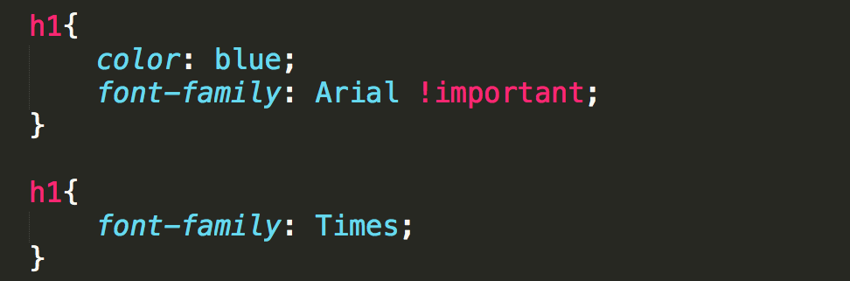
!important
It is possible to override later rules, use
!important

Slide 23
Example

Slide 24
Review
Why do we want/need to separate content from formatting?
How does this also tie in to external/internal style sheets?
Understand that this is very powerful. See http://www.csszengarden.com/

Slide 25
Acknowledgements/Contributions
These slides are Copyright 2015- Colleen van Lent as part of http://www.intro-webdesign.com/ and made available under a Creative Commons Attribution Non-Commercial 4.0 License. Please maintain this last slide in all copies of the document to comply with the attribution requirements of the license. If you make a change, feel free to add your name and organization to the list of contributors on this page as you republish the materials.
Initial Development: Colleen van Lent , University of Michigan School of Information

Slide 26
Colors
Using the best colors for your site

Slide 27
Color Conventions
Color names (blue, red, yellow, etc.) work, but should be avoided
Hexadecimal is common convention
#0000FF, #FF0000, #FFFF00
rgb
(0, 0, 1), (1, 0, 0), (1, 1, 0)
rgba
(0, 0, 1, .5)
#0000FF
#FF0000
#FFFF00
rgb(0,0,1)
rgba(0, 0, 1, .5)

Slide 28
Accessibility
Appropriate use of color is critical to web accessibility
Many more people are visually impaired or color blind than are legally blind

Slide 29
What is color contrast?
You intuitively know when something has poor contrast
There are tools that quantify the contrast between text and its background
http://wave.webaim.org/
http://webaim.org/resources/contrastchecker/

Slide 30
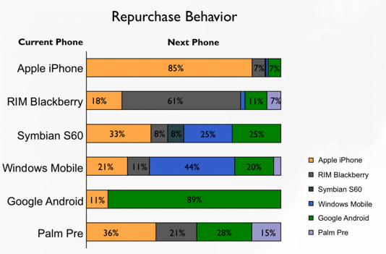
Don’t use color alone to convey meaning

Slide 31
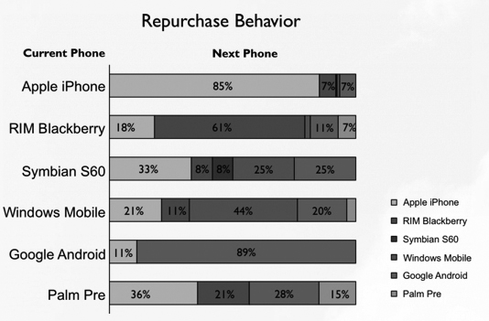
Test in gray scale …

Slide 32
Review
Use web safe colors and use an accepted convention
Test your site using a contrast checker
Avoid using color to convey meaning

Slide 33
Acknowledgements/Contributions
These slides are Copyright 2015- Colleen van Lent as part of http://www.intro-webdesign.com/ and made available under a Creative Commons Attribution Non-Commercial 4.0 License. Please maintain this last slide in all copies of the document to comply with the attribution requirements of the license. If you make a change, feel free to add your name and organization to the list of contributors on this page as you republish the materials.
Initial Development: Colleen van Lent , University of Michigan School of Information

Slide 34
Styling Your Text
Styling your text

Slide 35
Options
Many options for styling your text:
font (family, style, variant, size)
color and background
alignment
line-height

Slide 36
font-family
Font families are styles of text
Examples:
Helvetica, Courier, “Courier New”, “Comic Sans MS”, cursive, Verdana

Slide 37
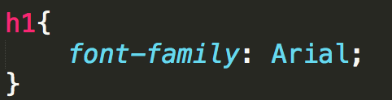

font-family

Slide 38
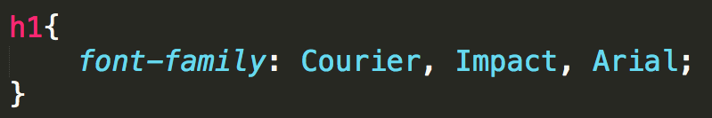
font-family
Not all font-families supported by all of the operating systems, so you can provide alternatives.

Slide 39
font-family Considerations
Some fonts are not as user-friendly, use sans-serif when possible.
Test
Test

Slide 40
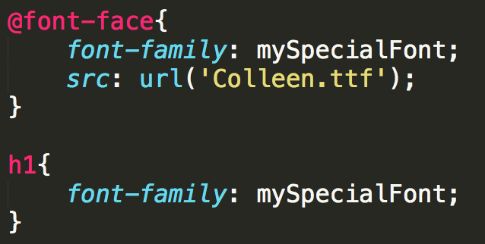
Custom fonts
To expand beyond "web-safe" fonts use @font-face

Slide 41
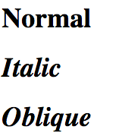
font-style
font-style:
normal
italic
oblique

Slide 42
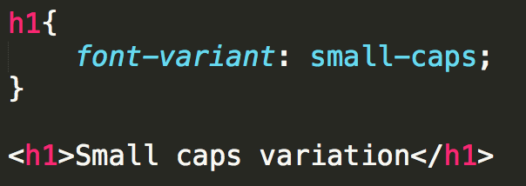
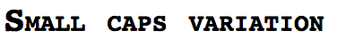
font-variant
font-variant:
normal
small-caps

Slide 43
font-size
This is only the beginning of our discussion on sizes…
Options
xx-small, x-small, small, smaller
medium
larger, x-large, xx-large, larger
Use pixel
Use %

Slide 44
color and background-color
The color attribute is the color of the foreground.
The background-color is the color of the background

Slide 45
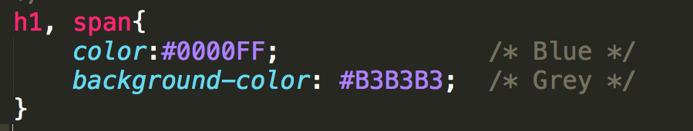
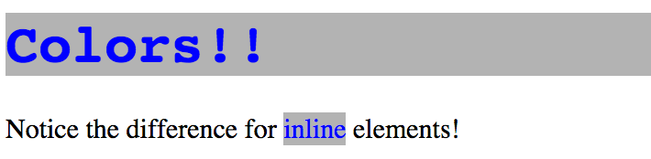
colors

Slide 46
text-align
Aligning text is simple!
text-align
left
right
center
justify

Slide 47
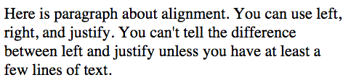
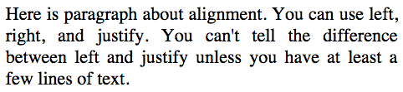
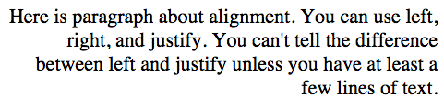
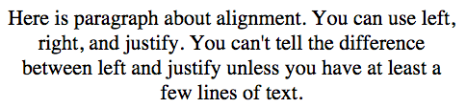

Slide 48
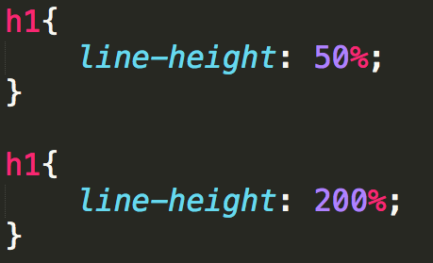
line-height
As you can guess, doesn’t affect font
Adjusts the space between the lines of text

Slide 49
Review
The number of options for styling text can seem overwhelming.
Practice on toy problems!
Design larger projects on paper first!!!

Slide 50
Acknowledgements/Contributions
These slides are Copyright 2015- Colleen van Lent as part of http://www.intro-webdesign.com/ and made available under a Creative Commons Attribution Non-Commercial 4.0 License. Please maintain this last slide in all copies of the document to comply with the attribution requirements of the license. If you make a change, feel free to add your name and organization to the list of contributors on this page as you republish the materials.
Initial Development: Colleen van Lent , University of Michigan School of Information

Slide 51
Display and Visibility

Slide 52
Display is Key to Layout
Every element is a box
Display affects the layout of neighboring elements

Slide 53
Common Values
inline: sits next to other elements
takes up “just enough” width and height
block: forces line break
default: take up all horizontal width and “just enough” height
rules can set height and width

Slide 54
Common Values
inline-block:
same as inline, but accepts height and width
none: removed from page
Still in DOM, but not visual (even to SRs)

Slide 55
Example

Slide 56
Complementary Properties
float
Reposition elements to the right or left.
Elements are aware of one another and will not overlap.
Values: left, right
clear
Used to keep floating elements away
Values: left, right, both

Slide 57
Example

Slide 58
Element Overflow
What happens when you set a height/width and the content doesn’t fit any longer?
Use overflow to determine access

Slide 59
Overflow
visible: Can cause text to show up “on top” of other text
hidden: Hides anything that goes beyond bounding box
This can cause problems since if the user increases font size, they may not be able to see content
scroll: Gives horizontal and vertical scrollbars
auto: Adds scrollbars as needed

Slide 60
Example

Slide 61
Other Display Values
New display properties are available, but not always supported:
Table
Grid
Flexbox

Slide 62
display:table
Sometimes you want to have table-like layout without using table structure, use display:table along with display:table-cell for elements.

Slide 63
Example

Slide 64
Visibility
Specifies whether or not element is visible
Options include:
visible
hidden
collapse (only for table elements)
Unlike display:none a hidden element is still part of the DOM and still takes up space

Slide 65
Review
Display is just one tool for positioning our elements on the page
Early design will make the coding easier
Utilize tools to see the different options

Slide 66
Acknowledgements/Contributions
These slides are Copyright 2015- Colleen van Lent as part of http://www.intro-webdesign.com/ and made available under a Creative Commons Attribution Non-Commercial 4.0 License. Please maintain this last slide in all copies of the document to comply with the attribution requirements of the license. If you make a change, feel free to add your name and organization to the list of contributors on this page as you republish the materials.
Initial Development: Colleen van Lent , University of Michigan School of Information

Slide 67
Homework One
Adding style with an external Style Sheet

Slide 68
Objective
Create your own unique style sheet that will be used by three different html files.

Slide 69
Before
http://www.intro-webdesign.com/CSS/assignment-1/index.html
http://www.intro-webdesign.com/CSS/assignment-1/teams.html
http://www.intro-webdesign.com/CSS/assignment-1/history.html

Slide 70
After
http://www.intro-webdesign.com/CSS/assignment-1/index.jpg
http://www.intro-webdesign.com/CSS/assignment-1/teams.jpg
http://www.intro-webdesign.com/CSS/assignment-1/history.jpg

Slide 71
You must leave the HTML alone
Create style sheet that updates:
header, headings, section, links and images

Slide 72
header
Change background color

Slide 73
h1 and h2
Change the font color
Make sure the heading is displayed in all capital letters
For just h1:
Center the text

Slide 74
section
Change the background color

Slide 75
Links
Change the background color and font color
Center the text (subtle change)

Slide 76
Images
Since we haven’t talked yet about the best way to get those images where we want them, just use CSS3 to remove them from the page.

Slide 77
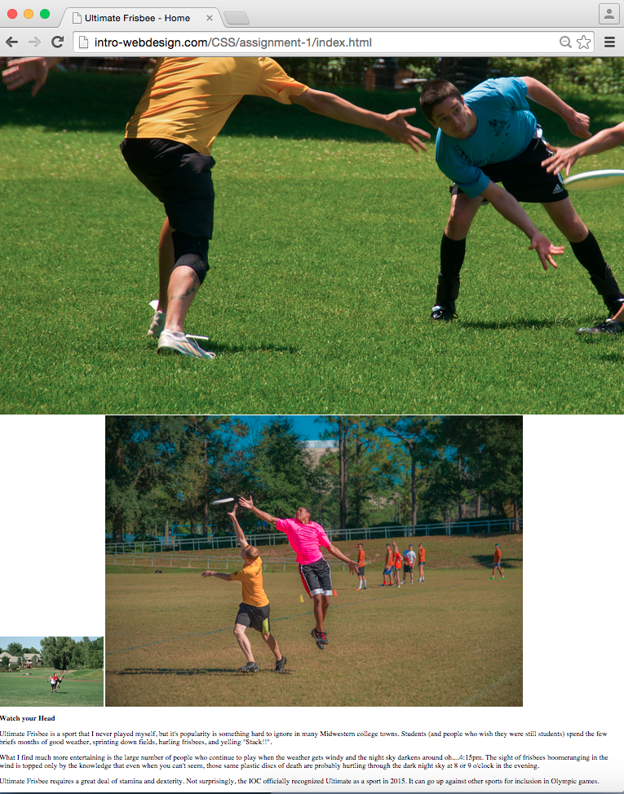
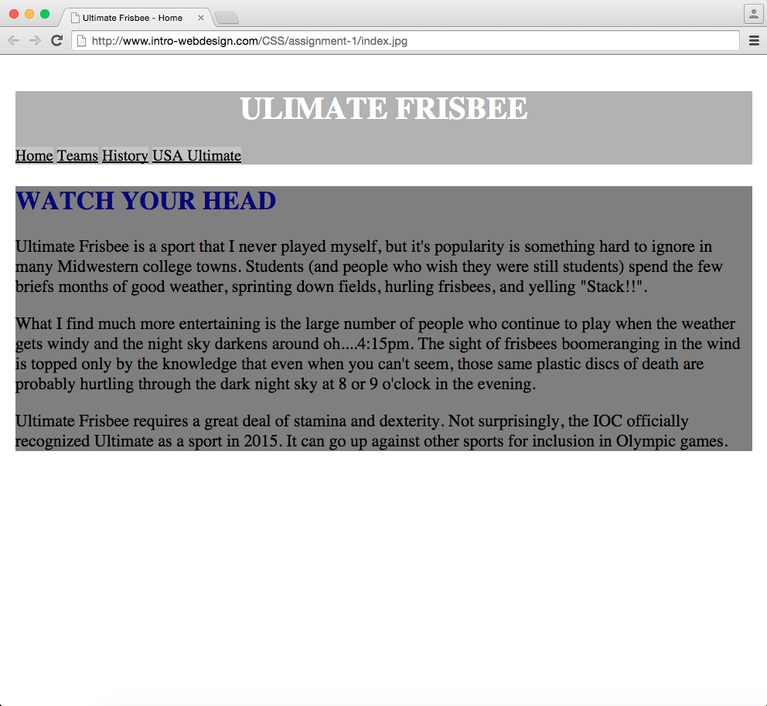
BEFORE
AFTER

Slide 78
Peer grading
Grades will be based on level of completion, not aesthetics
Proper standards do apply
Only style the listed elements, otherwise it makes it harder to grade

Slide 79
Acknowledgements/Contributions
These slides are Copyright 2015- Colleen van Lent as part of http://www.intro-webdesign.com/ and made available under a Creative Commons Attribution Non-Commercial 4.0 License. Please maintain this last slide in all copies of the document to comply with the attribution requirements of the license. If you make a change, feel free to add your name and organization to the list of contributors on this page as you republish the materials.
Initial Development: Colleen van Lent , University of Michigan School of Information

Slide 80
Box Model
Sizing your elements

Slide 81
Height and Width
The default width of inline elements is the content
Elements that are not inline can take width and height properties – we saw this in the Display lecture.

Slide 82
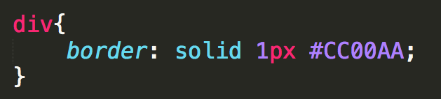
Border
Any element can have a border around it
border property specifies style, width, and color
The border style MUST be specified

Slide 83
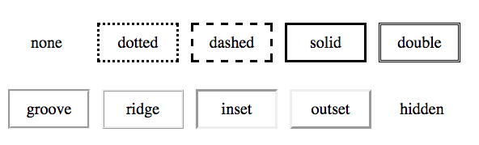
Border-style
none, dotted, dashed, solid, double, groove, ridge, inset, outset, hidden

Slide 84
Border width and color
Width
Set in pixels or thin, medium, or large
Color
Name - “blue”
RGB – rgb(0,0,255)
hex - #0000FF
transparent

Slide 85
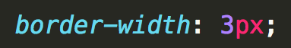

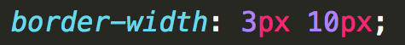

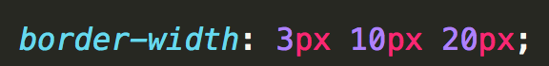


Specifying Individual Sides

Slide 86
Margin
Margin is additional space outside your border – between you and neighbor
Positive margin
element moves right/down
Negative margin
element moves left/upward

Slide 87
Padding
Padding is additional space between the element and its border.
Positive padding
border moves outward from element
Negative padding
border moves over the element

Slide 88
Margin and Padding
Neither takes a color (transparent)
Can also be defined in 1 - 4 values like border

Slide 89
padding
The empty space between the start of the element and the start of the text
margin
The space between the edge of the screen and the element
Here is my text

Slide 90
Additive Height and Width
Here is my text
Here is my text
margin
+ border
+ padding
+ width
= actual width

Slide 91
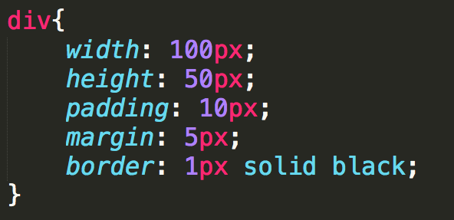
What is the width and height?
width = 132px:
height = 82:

Slide 92
Centering an Element
To horizontally center an element use:
margin: 0 auto;
But…
The element must display: block
The element must not float
The element must not have a fixed or absolute position
The element must have a width that is not auto

Slide 93
box-sizing
box-sizing takes some of the “math” out
Options:
content-box: default additive
border-box: width takes content, padding, and border into consideration

Slide 94
Measurements
Absolute – set to a specific size
px, mm, cm, pt, ….
Fluid – sets size relative to surrounding elements
%, vw, vh
em (for font): 1em is current size, .75 is 75% of the current size
rem (for font): 1rem is current size of root element

Slide 95
Example

Slide 96
Review
Design sketches should be done with box model (margin, border, padding, content) in mind.
Use box-model to reduce complexity
Margin must always be considered
Use fluid sizes for best viewing

Slide 97
Acknowledgements/Contributions
These slides are Copyright 2015- Colleen van Lent as part of http://www.intro-webdesign.com/ and made available under a Creative Commons Attribution Non-Commercial 4.0 License. Please maintain this last slide in all copies of the document to comply with the attribution requirements of the license. If you make a change, feel free to add your name and organization to the list of contributors on this page as you republish the materials.
Initial Development: Colleen van Lent , University of Michigan School of Information

Slide 98
Styling Links and Lists

Slide 99

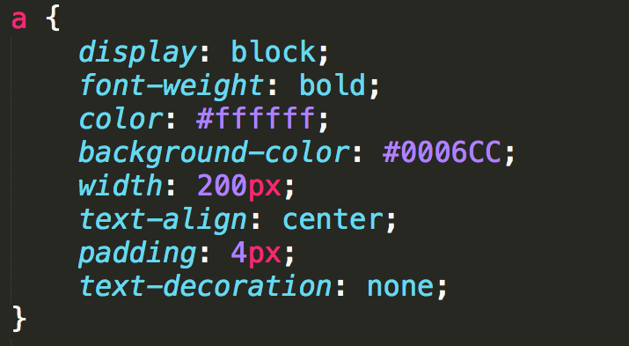

Anchor Links
Links can take on all of the usual styles as well as text-decoration

Slide 100
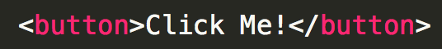
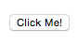
“Buttons”
Many designers try to make their links look like buttons.
Be semantic, if you want a button use the <button> element instead.

Slide 101
States
Some links are blue, some are purple, etc. Why???
a:link: a normal, unvisited link
a:visited has been visited
a:hover activated by mouse (touchscreens….?)
a:focus activated with the keyboard
a:active is being clicked

Slide 102
Precedence of Rules
a:hover MUST come after a:link
a:visited and a:active MUST come after a:hover

Slide 103
Example

Slide 104
Styling Lists
Number of properties beyond font, margin, etc.
list-style-type
list-style-image
list-style-position
list-style

Slide 105
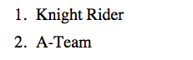
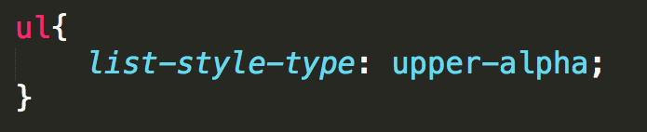
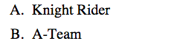
list-style-type
list-style-type
ordered lists
lower-roman, upper-roman, decimal, decimal-leading-zero, upper-alpha, lower-alpha, hebrew, armenian, …..

Slide 106
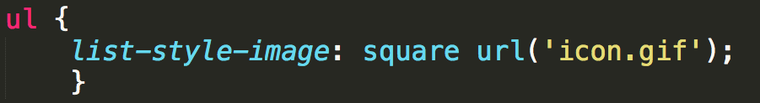
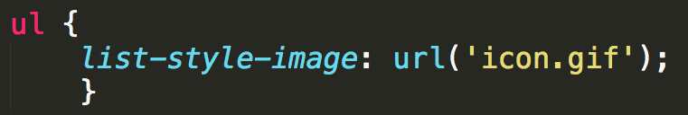
List styles
list-style-type
unordered lists
Override the default marker with circles, discs, or squares
list-style-image
Use a custom image instead of traditional marker

Slide 107
Example

Slide 108
Review
At this point you have learned how to write rules for the tags.
Embrace the many tools that are available to help you design your site.
http://chrispederick.com/work/web-developer/
http://css3generator.com/
Do web search for “Developer Tools”

Slide 109
Acknowledgements/Contributions
These slides are Copyright 2015- Colleen van Lent as part of http://www.intro-webdesign.com/ and made available under a Creative Commons Attribution Non-Commercial 4.0 License. Please maintain this last slide in all copies of the document to comply with the attribution requirements of the license. If you make a change, feel free to add your name and organization to the list of contributors on this page as you republish the materials.
Initial Development: Colleen van Lent , University of Michigan School of Information

Slide 110
Advanced Selectors

Slide 111
Styling Specific Objects
We have focused on type selectors.
What if you don’t want to style all of the links, just some? Or just some of the lists?
CSS gives you options

Slide 112
CSS Selectors
Some selectors follow the DOM
Descendant selectors (nav a)
Style all of the anchor links inside a nav tag
Child selectors (nav > a)
more constraining The anchor elements must be a child of the nav, no intermediate tags, e.g. paragraph
Adjacent sibling (h1 + o)
elements must be at same level and follow each other

Slide 113
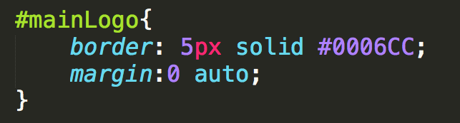
id Selectors
# id selector
Used to identify a single element in the DOM.
Was used extensively for <div id = “header”>, <div id=“footer”>, etc.
There is a small movement to move the use of id OUT of CSS

Slide 114
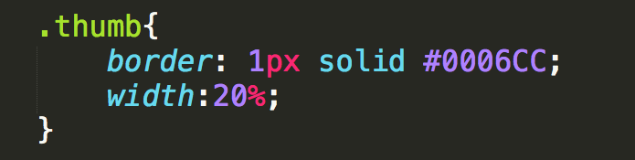
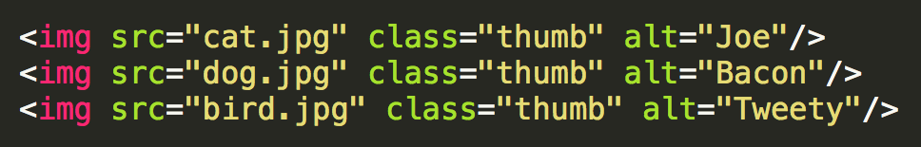
class Selector
. class selector
Used to identify an element in the DOM that is part of a special class of items
Think of thumbnail images, all of the links that are in the navigation, your social media images, etc….

Slide 115
classes vs. ids
Syntax is “.” and “#”
classes can be used multiple times
id should be unique
Think of images and navigation bars
Format numerous (but not all) images the same way
Visually signify the current page

Slide 116
Example

Slide 117
Narrowing the Scope
As you get more advanced pages, you will want to narrow the scope of the of action
p.main → paragraphs using main class
header img.special → paragraphs inside header that use special class

Slide 118
Expanding the scope
You can combine elements with a comma
p, h1, #main, .special{…rules to apply to all of them…}
Review : What happens when there are multiple rules for the same selector?
When there are conflicts, use the one processed most recently
UNLESS a rule has !important

Slide 119
More Attribute Selectors
Universal
* applies styling to every element on the page
Ackk!! Try this!
Attribute Selectors
a[href=‘info.html’]
PseudoClasses
Pseudo Elements

Slide 120
Attribute selectors
You may want to search the DOM for certain elements that have an attribute you are looking for
All the images that use gif files…..
All of the images that have empty alt text….
All of the links that go to government sites….

Slide 121
Using Operators
Operators can be used to find those attribute values you are looking for
^ : match the beginning exactly
a [href^=‘http://umich’]
$ : match the end exactly
img[src$ = ‘.png’] → apply to .png images
* : wildcard
a [href*=‘umich’]

Slide 122
Example

Slide 123
Whew!!!
We have actually covered a lot in this short video
Know that each of these ideas can merge. One element can have many classes and ids associated with it
Browser “starts at the top” and applies each rule, sometimes overriding earlier rules.

Slide 124
The Good News
You can use style sheets from others to style your code, just by adding class!!
You can override style sheets from others just by rewriting the class, or making your own version of it and linking it last.

Slide 125
Review
Type selectors can be combined to narrow the scope of where rules are applied
An id is used to specify a specific element in a page
Classes can be used to associate elements that should treated in a similar manner
Notes:
http://codepen.io/shayhowe/pen/FrCHn

Slide 126
Acknowledgements/Contributions
These slides are Copyright 2015- Colleen van Lent as part of http://www.intro-webdesign.com/ and made available under a Creative Commons Attribution Non-Commercial 4.0 License. Please maintain this last slide in all copies of the document to comply with the attribution requirements of the license. If you make a change, feel free to add your name and organization to the list of contributors on this page as you republish the materials.
Initial Development: Colleen van Lent , University of Michigan School of Information

Slide 127
Browser Capabilities
Designing for consistent appearance

Slide 128
Browsers Differ
Even though browsers are moving to a consistent implementation of HTML, they differ in display and adherence.
It is your responsibility to make sure your page works for a wide audience.

Slide 129
Handling Stylistic Differences
“Easiest” way to eliminate browser differences is to use a default style sheet
Default style sheets reset all of the values for the page
Will make your page look worse!

Slide 130
Handling Unsupported Properties
Not all browsers support all HTML5 tags
Not all browsers support all CSS3 properties
Browser prefixes (or vendor prefixes) provide a quick fix for handling unsupported CSS3 options.

Slide 131
Browser Prefixes
-webkit-: Android, Chrome, iOS, Safari
-moz-: Firefox
-ms-: Internet Explorer
-o-: Opera

Slide 132
Often Unsupported Properties
column-count
border-radius
gradient
Sites such as http://caniuse.com/ will tell you when you need to use prefixes

Slide 133
Example

Slide 134
Automated Ways to include Prefixes
For now, add the prefixes by hand
There are ways to automate the addition of prefixes
Editor add-ons (You have most of the control)
Use outside programs to dynamically add appropriate prefix based on browser

Slide 135
Review
Default style sheets remove stylistic differences
Should default style sheet be internal or external?
Where should it go in relation to other style sheets?
Browser prefixes can help remove some differences caused by unsupported options
Shouldn’t be overused

Slide 136
Acknowledgements/Contributions
These slides are Copyright 2015- Colleen van Lent as part of http://www.intro-webdesign.com/ and made available under a Creative Commons Attribution Non-Commercial 4.0 License. Please maintain this last slide in all copies of the document to comply with the attribution requirements of the license. If you make a change, feel free to add your name and organization to the list of contributors on this page as you republish the materials.
Initial Development: Colleen van Lent , University of Michigan School of Information

Slide 137
Designing for Accessibility
POUR

Slide 138
Overview
The content of your page should be in the HTML.
It is tempting to add content via colors, images, etc.
Follow the POUR guidelines
Perceivable, Operable, Understandable, Robust

Slide 139
Perceivable
Provide text alternatives for images
Provide captions and transcripts for video and audio
Use correct semantic markup so content can be presented in different ways
Make it easier for users to see content by using good color contrast

Slide 140
Operable
All functionality available from the keyboard!
Users have control over timing and limits
Do not cause seizures (don’t flash content)
Provide ways to help users navigate, find content, and determine where they are

Slide 141
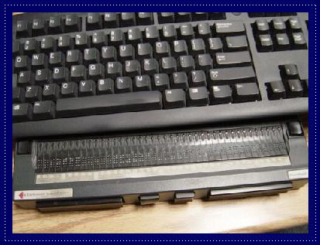

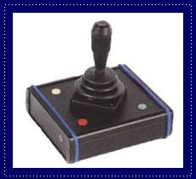
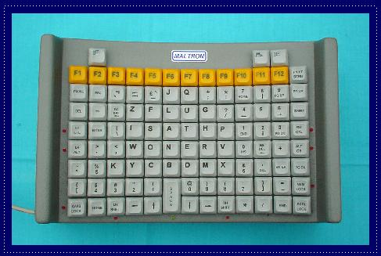
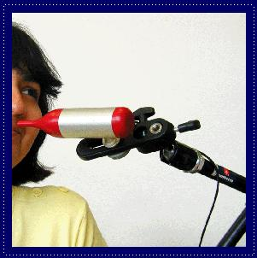

Slide 142
Understandable
Economical and plain use of language
Text supplemented with illustrations, videos, and other formats where appropriate (i.e., use good Universal Design)
Navigation, information structure are discernable and consistent
Make pages operate in predictable ways
Help users avoid and correct mistakes
Notes:
Chunking appropriately, avoiding jargon or institutional language, avoid URL descriptors
Different learning modalities, visual versus verbal
Don’t change nav and layout structure
Careful with AJAX-y elements, pop-ups
Considerate form validation and error correction

Slide 143
Robust
Is your site functional across various technologies (smart phone, screen reader, laptop, pensticks, etc..)?
Syntax errors that don’t affect visual presentation may hamper assistive technology and accessibility tools
Adhering to W3C standards ensures future compatibility
Validate your code at validator.w3c.org and wave.webaim.org

Slide 144
Review
Accessibility starts with proper HTML tags
Styling can actually make it HARDER for some people to access the information
Get into the early habit of utilizing accessibility tools
“Cool” new style should not be at the cost of accessibility

Slide 145
Acknowledgements/Contributions
These slides are Copyright 2015- Colleen van Lent as part of http://www.intro-webdesign.com/ and made available under a Creative Commons Attribution 4.0 License. Please maintain this last slide in all copies of the document to comply with the attribution requirements of the license. If you make a change, feel free to add your name and organization to the list of contributors on this page as you republish the materials.
Initial Development: Colleen van Lent , University of Michigan School of Information

Slide 146
Homework Two
Adding more style with an external CSS

Slide 147
Objective
Create your own unique style sheet that will be used by three different html files.

Slide 148
Getting Started
You must complete the first Peer Graded Assignment to begin this one.
You can alter your previous styling choices but I assume those changes are complete

Slide 149
Before
http://www.intro-webdesign.com/CSS/assignment-2/index.html
http://www.intro-webdesign.com/CSS/assignment-2/teams.html
http://www.intro-webdesign.com/CSS/assignment-2/history.html

Slide 150
After
http://www.intro-webdesign.com/CSS/assignment-2/index.jpg
http://www.intro-webdesign.com/CSS/assignment-2/teams.jpg
http://www.intro-webdesign.com/CSS/assignment-2/history.jpg

Slide 151
You must leave the HTML alone
Create a single style sheet that updates:
body, header, h1, the links, the active, left, and right classes, and the images in the left class.

Slide 152
body
Change the padding and margin
Feel free to adjust the size of the text, but it is not required

Slide 153
header
Change background color
Add background image, using the image provided in the css folder
If you have trouble with this part, keep an eye out for sample code in cal-table.css. The key is to master the folder structure

Slide 154
h1
Change the font color
Increase the font size

Slide 155
The navigation links
Style ONLY those links in the nav element.
You don’t need to recreate my example exactly, but they should be spaced apart.
Make sure to round the borders and removed the underline.

Slide 156
active class
Use the background color and font color to create an active class.
This class is used to distinguish the current page from the others

Slide 157
left and right class
These two elements should be side-by-side.
Change the background color for the left class.

Slide 158
Images
Put the images back in and put a border around them
Make sure that they are centered within the .left class
Put spacing between them on the top and bottom too

Slide 159
Peer grading
Grades will be based on level of completion
Some aesthetics will come into play this time. It is important that things are not “squished” together
Proper standards do apply
You can specify your preferred screen size for grading.

Slide 160
Acknowledgements/Contributions
These slides are Copyright 2015- Colleen van Lent as part of http://www.intro-webdesign.com/ and made available under a Creative Commons Attribution Non-Commercial 4.0 License. Please maintain this last slide in all copies of the document to comply with the attribution requirements of the license. If you make a change, feel free to add your name and organization to the list of contributors on this page as you republish the materials.
Initial Development: Colleen van Lent , University of Michigan School of Information

Slide 161
Pseudo Classes and Elements
Designing for consistent appearance

Slide 162
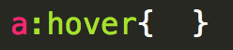
Pseudo-Classes
Elements that are dynamically populated or dependent on tree structure
You have seen this before…

Slide 163
Types of Pseudo-Classes
Link
:link, :visited
User Action
:hover, :active, :focus
Forms (interfaces)
:enabled, :checked, :disabled

Slide 164
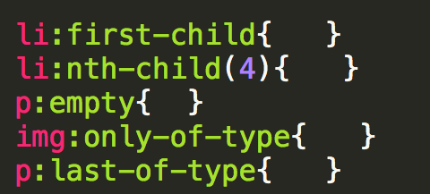
Types of Pseudo-Classes
Structural/Positional
:first-child, :last-child, :nth-child(), :only-child
:first-of-type, :last-of-type, :only-of-type

Slide 165
Example

Slide 166
Pseudo-Elements
These elements aren’t part of the DOM
Can be used to style specific (unique) parts of the page

Slide 167
Types of Pseudo-Elements
Textual
:first-letter, :first-line
Positional/Generated
:before, :after
Fragments
::selection

Slide 168
Example

Slide 169
Review
Pseudo-elements and classes are just one more way to add style to your page
I haven’t covered every combination so make sure to do some investigation on your own

Slide 170
Acknowledgements/Contributions
These slides are Copyright 2015- Colleen van Lent as part of http://www.intro-webdesign.com/ and made available under a Creative Commons Attribution Non-Commercial 4.0 License. Please maintain this last slide in all copies of the document to comply with the attribution requirements of the license. If you make a change, feel free to add your name and organization to the list of contributors on this page as you republish the materials.
Initial Development: Colleen van Lent , University of Michigan School of Information

Slide 171
Transitions

Slide 172
Transitions
When elements transition from one state to another, you can alter their appearance
If you hover over the link, change the color
If an image comes into focus, change the size,

Slide 173
The Properties
transition-property
What is it you want to change? (size, color, position, etc.)
transition-duration
How long should each transition last?
transition-timing
Should it be a smooth transition (linear)? Or different?
transition-delay
How long should the wait be before the transition begins?

Slide 174
Setting up
Define your element
Choose the elements for transition
Define the new values
You must combine this step with a pseudo-class

Slide 175
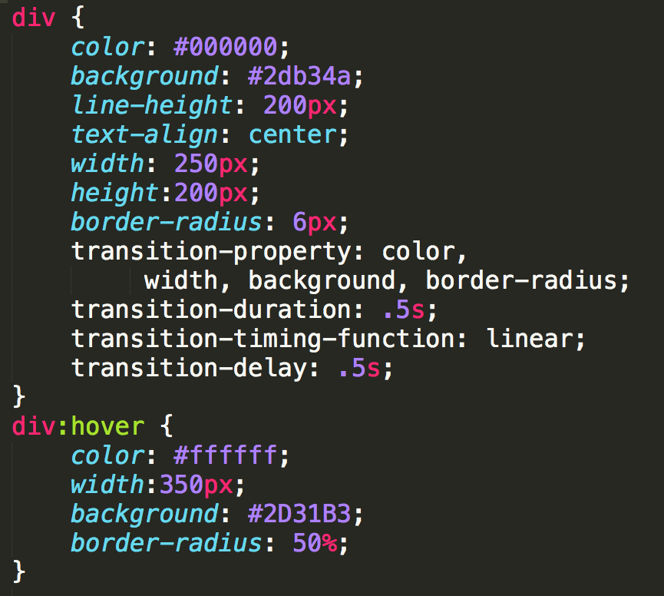
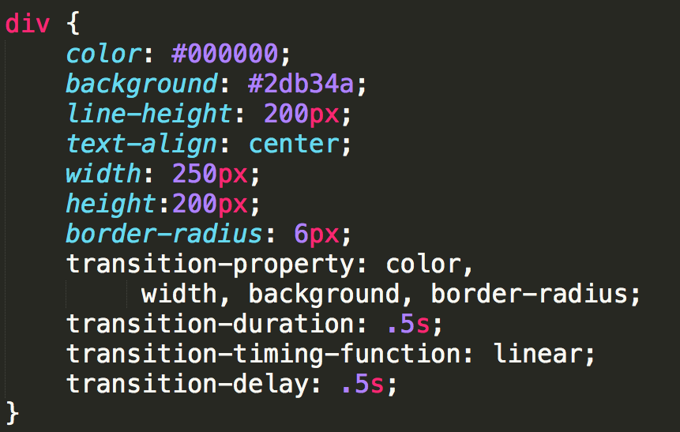
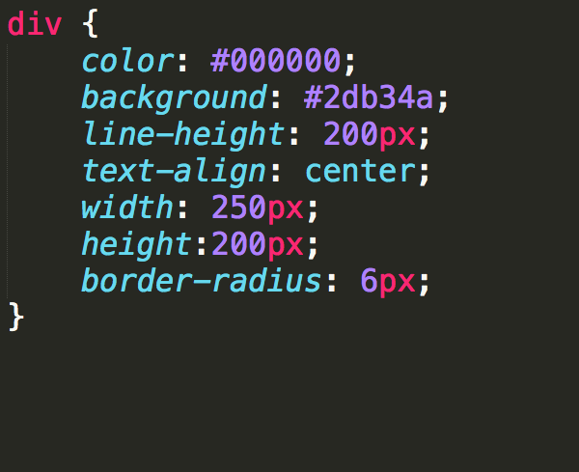
Example (CSS3-transitions)

Slide 176
Using Shorthands
If you have multiple properties transitioning, you can use shorthand:

Slide 177
Review

Slide 178
Acknowledgements/Contributions
These slides are Copyright 2015- Colleen van Lent as part of http://www.intro-webdesign.com/ and made available under a Creative Commons Attribution Non-Commercial 4.0 License. Please maintain this last slide in all copies of the document to comply with the attribution requirements of the license. If you make a change, feel free to add your name and organization to the list of contributors on this page as you republish the materials.
Initial Development: Colleen van Lent , University of Michigan School of Information

Slide 179
Transforms

Slide 180
Transforms
Provide option for changing the appearance of elements
Two-dimensional
Three-dimensional

Slide 181
2D Transform Options
Options
translate
rotate
scale
skew
matrix

Slide 182


translate
transform:translate(x, y);
move x pixels to the left/right and y pixel up/down
transform:translate(100, 75);

Slide 183

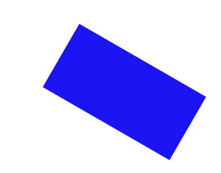
rotate
transform:rotate(deg);
Rotate/”spin” the element a certain number of degrees
transform:rotate(30deg);

Slide 184


scale
transform:scale(width, height);
Change the width and height of the element
transform:scale(2,3);

Slide 185


skew
transform:skew(x-angle, y-angle);
Rotate the element a certain number of degrees along the x and y axis
transform:skew(30deg, 15deg)

Slide 186
matrix
matrix() - combines all of the 2D transform methods into one

Slide 187
3D rotate
You can rotate along the x, y, or z dimension along a given degree
transform:rotateY(deg)
transform:rotateX(deg)
transform:rotateZ(deg)
transform:rotate3d(x, y, z)

Slide 188
Others
3D scale
3D translate

Slide 189
Review
Transforms are one more way to modify the look of your page.
Often combined with state changes
Will typically require browser prefixes.

Slide 190
Acknowledgements/Contributions
These slides are Copyright 2015- Colleen van Lent as part of http://www.intro-webdesign.com/ and made available under a Creative Commons Attribution-NonCommercial 4.0 License. Please maintain this last slide in all copies of the document to comply with the attribution requirements of the license. If you make a change, feel free to add your name and organization to the list of contributors on this page as you republish the materials.
Initial Development: Colleen van Lent , University of Michigan School of Information

Slide 191
Positioning

Slide 192
Positioning!
Putting elements where you want them can be time-consuming and frustrating
Why not tables?

Slide 193
Position Properties
The four position properties are:
static
relative
absolute
fixed
Position properties are modified by the properties: top, right, bottom, left

Slide 194
Static
Default value for elements
Place in the next available position
Not affected by the top, bottom, left, and right properties.

Slide 195
Relative
Positioned “relative to itself”
Take the static position, but add offsets.
The new positioning does NOT affect any other element. It is possible to move an element and leave a big hole where it would have been.
Relatively positioned elements are often used as container blocks for absolutely positioned elements.

Slide 196
Absolute
Element is removed from the document flow and positioned relative to it’s nearest ancestor (or the root)
Other elements behave as if element does not exist
Can end up on top of another element

Slide 197
Fixed Position
Positioned relative to the browser window
Will not move, even if the window is scrolled
IE7 and IE8 support the fixed value only if a !DOCTYPE is specified
Think of popup boxes that wont’ go away!!!
Or a navigation bar that is always visible on the top

Slide 198
Example

Slide 199
Z-index
Multiple elements may be placed in the same position.
z-index is a numeric value, positive or negative that dictates stacking order

Slide 200
Example

Slide 201
Review
Positioning elements is key to achieving desired layouts
Proper planning will make this easier

Slide 202
Acknowledgements/Contributions
These slides are Copyright 2015- Colleen van Lent as part of http://www.intro-webdesign.com/ and made available under a Creative Commons Attribution Non-Commercial 4.0 License. Please maintain this last slide in all copies of the document to comply with the attribution requirements of the license. If you make a change, feel free to add your name and organization to the list of contributors on this page as you republish the materials.
Initial Development: Colleen van Lent , University of Michigan School of Information

Slide 203
Accessible Navigation

Slide 204
Navigation
Navigation is a critical aspect of accessibility
Sighted users have tried and true visual cues to orient them on a page
Banner
Search box
Main navigation box
Content well
Blind and low-vision users rely on proper coding of page for orientation
Notes:
Why can’t I animate the last bullet correctly?!?!?

Slide 205
What if you can’t see?
Title of page lets you know what page you’re on when page loads
Proper heading placement and hierarchy conveys organization of page and allows SR users to skip navigation
Link descriptions convey content of page and organization of site
Notes:
What are those holds?

Slide 206
Proper <h1> heading
Screen readers can find and list headings
<h1> heading uniquely identifies the page in the website
Should be placed directly in front of the main content of the page
The <h1> header should also match at least a subset of the the page <title>

Slide 207

Proper heading hierarchy
Headings need to be properly nested to convey organization of the page
<h2> tags follow the <h1> tag, the <h3> tags follow the <h2> tags, etc.
Notes:
Don’t select heading levels for their default size—use CSS to style your headings.

Slide 208

Off-page headings
Useful when you want to give SR users a navigational aid without cluttering presentation
Use CSS to position headings off-page
Don’t use {display: none} or {visibility: hidden}

Slide 209
Meaningful link text
Screen readers can find and list links
Descriptions for the links must be meaningful out of context, via tabbing or presented in a list
Don’t use “here”, “click here”, “read this”, and “more”
Don’t use URL as a link description—will sound like gibberish, unless very short and intuitive

Slide 210
Review
How easy is it to navigate your page?
What would happen if the colors weren’t there?
What would happen if you couldn’t use a mouse?
Plan for everyone

Slide 211
Acknowledgements/Contributions
These slides are Copyright 2015- Colleen van Lent as part of http://www.intro-webdesign.com/ and made available under a Creative Commons Attribution Non-Commercial 4.0 License. Please maintain this last slide in all copies of the document to comply with the attribution requirements of the license. If you make a change, feel free to add your name and organization to the list of contributors on this page as you republish the materials.
Initial Development: Colleen van Lent , University of Michigan School of Information

Slide 212
Final Project

Slide 213
Objective
Create your own unique style sheet that will be used by three different html files.

Slide 214
Getting Started
You must complete the second Peer Graded Assignment to begin this one.
You can alter your previous styling choices but I assume those changes are complete

Slide 215
Before
http://www.intro-webdesign.com/CSS/final/index.html
http://www.intro-webdesign.com/CSS/final/teams.html
http://www.intro-webdesign.com/CSS/final/history.html

Slide 216
After
http://www.intro-webdesign.com/CSS/final/index.jpg
http://www.intro-webdesign.com/CSS/final/teams.jpg
http://www.intro-webdesign.com/CSS/final/history.jpg

Slide 217
You must leave the HTML alone
Create a single style sheet that styles the table
You will use pseudo-elements and pseudo-classes

Slide 218
table
Style at a minimum:
Font – multiple families, size, weight, and line-height
Width – don’t take up the entire space
Margin – center the table

Slide 219
table heading
Change background color
Try to use a gradient
Add a border
Round only the top two corners.
Make the bottom border thicker
Add at least one other property

Slide 220
table rows
Set the opacity to a value of about .8
Left align the first column, center the other two
Set the opacity to a value of 1 when the element hovered upon.

Slide 221
td
Change the padding, font color, background color, and set the border radius to 2px.
Optional: use text-shadow

Slide 222
Peer grading
Grades will be based on level of completion
Proper standards do apply
You can specify your preferred screen size for grading.

Slide 223
Acknowledgements/Contributions
These slides are Copyright 2015- Colleen van Lent as part of http://www.intro-webdesign.com/ and made available under a Creative Commons Attribution Non-Commercial 4.0 License. Please maintain this last slide in all copies of the document to comply with the attribution requirements of the license. If you make a change, feel free to add your name and organization to the list of contributors on this page as you republish the materials.
Initial Development: Colleen van Lent , University of Michigan School of Information

Slide 224
Closing

Slide 225
Congratulations
You have come a long way from the plain pages we began with!

Slide 226
What next?
Consider creating your own site
Continue to practice your skills
You are ready to join a Meet Up, or offer your skills as a TA at workshops.
Begin to learn about using JavaScript to add interactive elements to your site
Learn more about Responsive Design

Slide 227
Thank you!

Slide 228
Acknowledgements/Contributions
These slides are Copyright 2015- Colleen van Lent as part of http://www.intro-webdesign.com/ and made available under a Creative Commons Attribution-NonCommercial 4.0 License. Please maintain this last slide in all copies of the document to comply with the attribution requirements of the license. If you make a change, feel free to add your name and organization to the list of contributors on this page as you republish the materials.
Initial Development: Colleen van Lent , University of Michigan School of Information

